Slide 1


KLE College of Pharmacy Vidyanagar, Huballi - 580031 (A Constituent unit of KAHER Belagavi, Deemed-to-be-university) Karnataka.
THIRD DISSERTATION PRESENTATION
Presented by: Mahima A Mudhole
Dept of Pharmaceutics,
KLE College of Pharmacy,
Hubballi.
Guided by : Mr. Harish K H
Associate Professor
Department of Pharmaceutics,
KLE College of Pharmacy,
Hubballi

Slide 2


TITLE :
“FORMULATION AND EVALUATION OF TOPICAL MICROEMULGEL FOR TREATMENT OF MELASMA”

Slide 3
CONTENTS
Introduction
Review of literature
Need for study
Objectives
Materials required
Methodology
Solubilities studies
Study on phase titration method
Pseudo trnary diagram
Formulation of microemulgel
placebo
Standard caliberation curve
Evaluation of prepared microemulsion
Drug content analysis
Measurement of particle size and zeta potential
Formulation of microemulgel containing drug.
Physical evaluation of microemulgel.
Invitro diffusion test

Slide 4
ABSTRACT
AIM: To formulate and evaluate microemul-based gel.
OBJECTIVE: Formulation and evalution of microemulbased gel for topical application by using metformin HCL for treatment of melasma.
METHOD: Phase titration method by using pseudo ternary diagram.
RESULTS: After the selection of oil water and surfactant by observed solubilities and HLB values the microemulsion was preapared by phase titration method.The mixture present in conical was observed as clear transparent mixture to conclude as microemulsion. Later,these microemulsions were subjected to further optimized study by some evaluations{Viscosity,pH,%transmittance,drug content,and thermodynamic study}.On the basis of drug content further formulation among microemulsions were selected for formulationof microemulbased gels. These optimized microemulgels were evaluated{ Drug content,spreadability,homogeneity,pH,viscosity}.
KEY WORDS: Microemulsions,Metfformin HCL,Melasma.

Slide 5

INTRODUCTION
Melasma, formerely known as choalasma, is a pigamentary disorder that develops over time and most frequently affects the face. Melasma is a common acquired pigmentary disorder that manifests as a symmertric hyperpigmented macules and patches on the face, more frequently affecting women of reproductive age.
The main causees if this condition, which affects more women and those with darker skin tones, include UV exposure and hamonal factors.
There are certain known triggering variables such as sun exposure, pregnancy, sexual hormones, inflammatory skin conditions, usage of cosmetics, steroids, ovarian tumours ,intestinal parasites, hepatopathies hormone replacement therapy and photosensitizing medications.
Melasma causes patients distress since it mostly affects the face, is readily visible, and is always present in daily life. In this situation, it has deterimental effect on patients quality of life, hurting their psychological and emotional health, which frequently prompts them to look for a dermatologists.

Slide 6

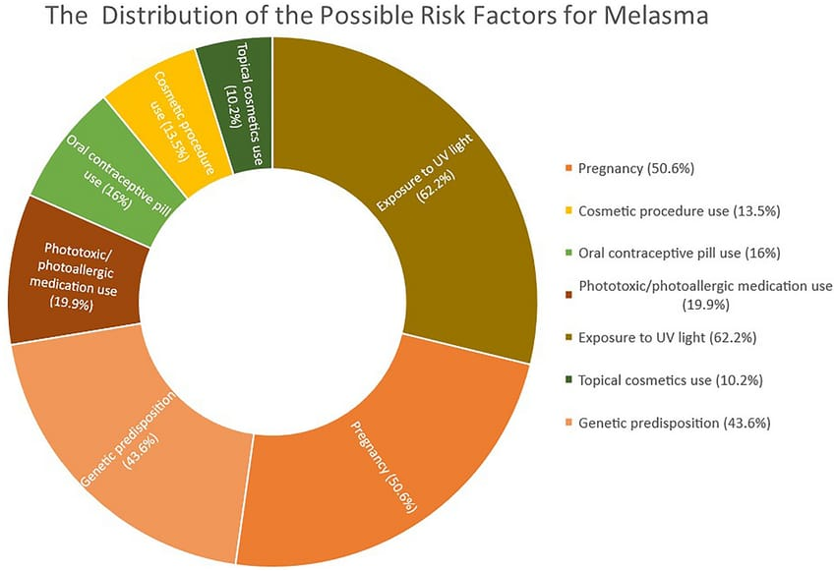

Slide 7
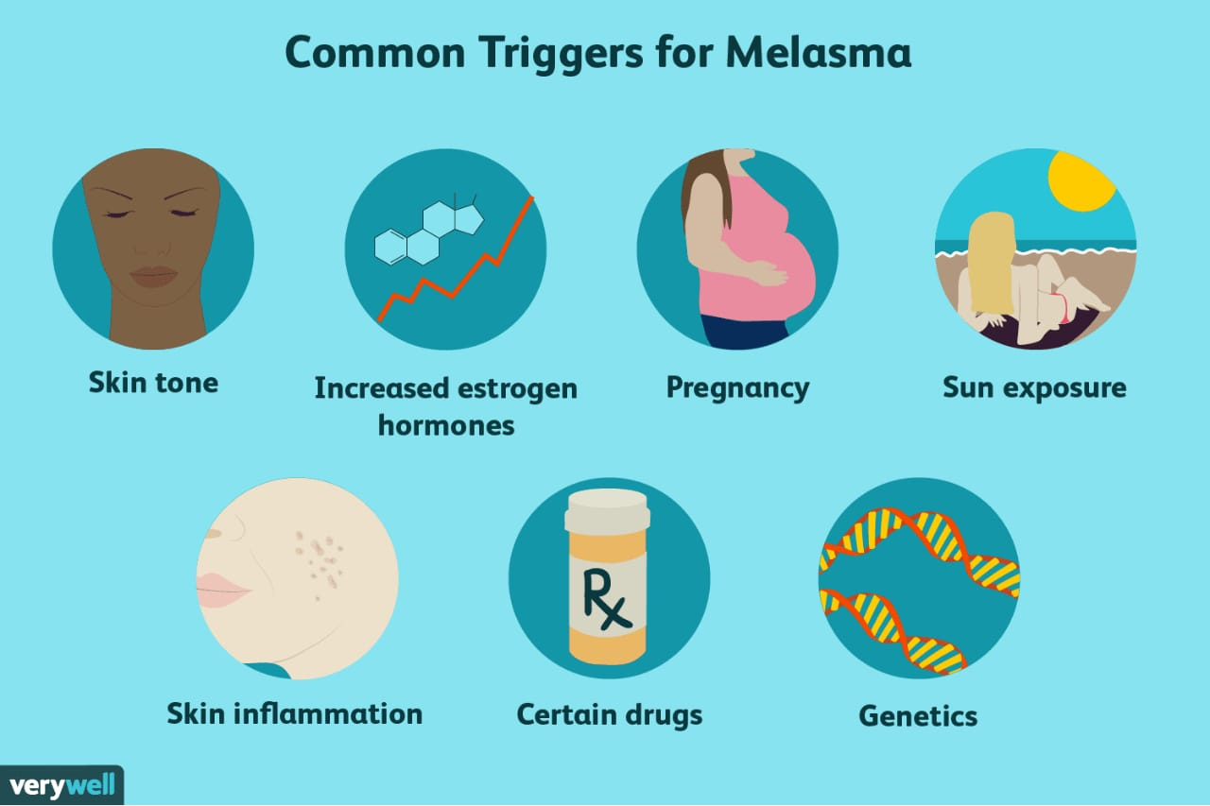
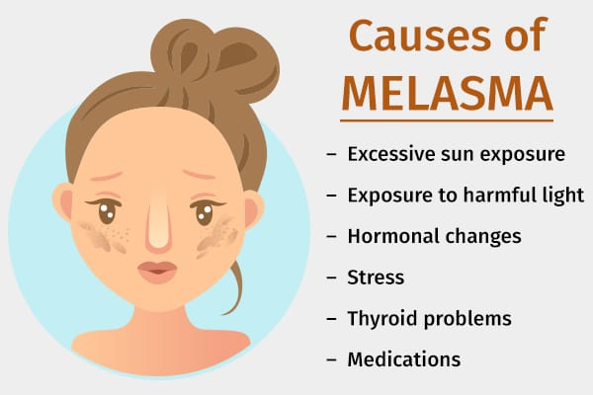

Slide 8
Recently, in vitro studies have shown that Topical metformin has melanopenic action, which is due to downregulation of the expression of MITF { Melanocyte inducing transcription factor } which inturn leads to downregulation of transcription of various melanogenic proteins such as tyrosinase, TRP-1, TRP-2 and protein kinase C-beta.
The study was undertaken to formulate, optimize and evaluate the safety and efficacy of topical metformin in melasmaicroemulsion based gels.
Microemulgel
The micron - sized globules of microemulgel have higher penetration, allowing the medicine to reach systemic circulation directly. This improves both the drugs bioavailability and patient compliance .
The microemulgel for dermatological and cosmetic use has a variety of desirable qualities including good consistency, being thixotropic, easily spreadable, non-staining, emollient, biofriendly, clear, transparent and elegant appearance. Additionally, these microemulgel - based formulations improves the skin deposition of API, ultimately increasing its therapeutic activity.

Slide 9
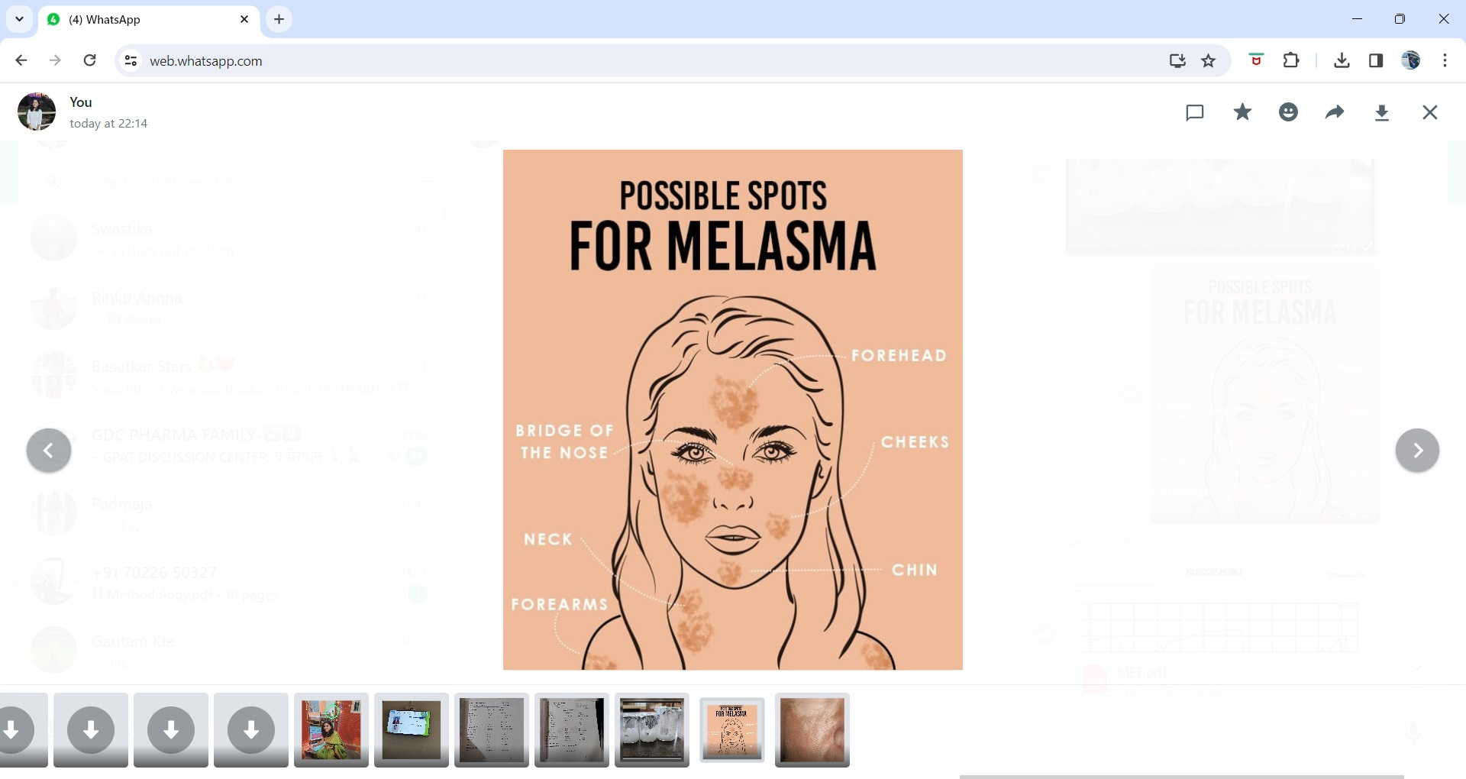
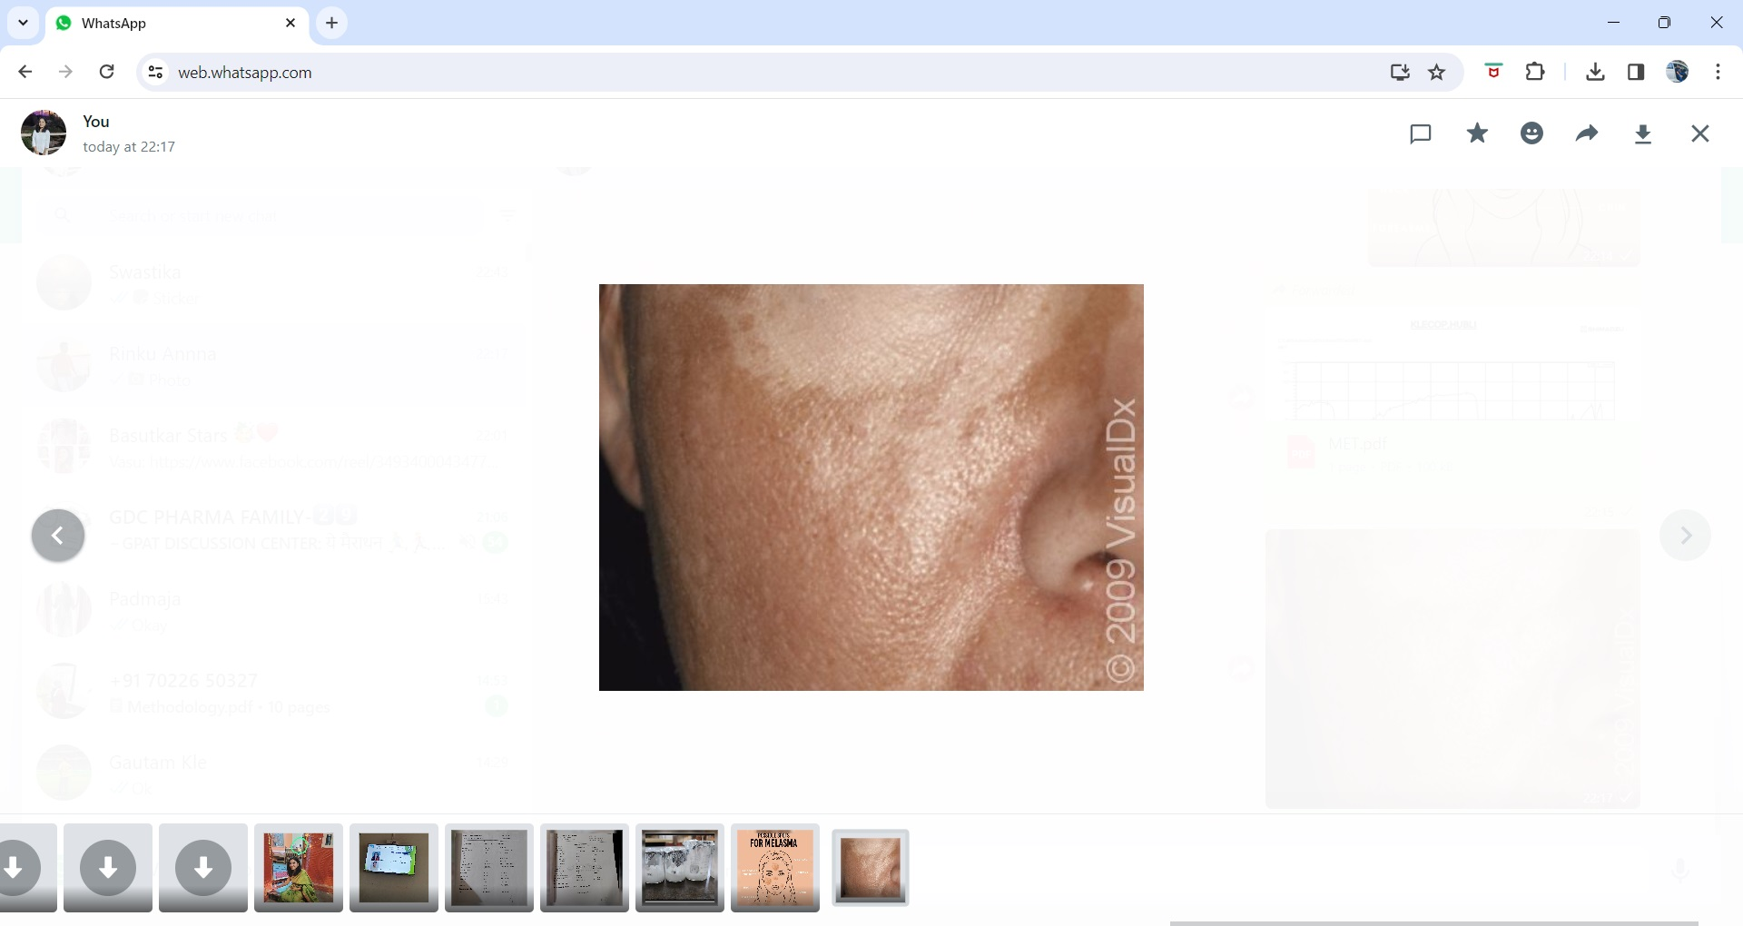

Slide 10

REVIEW OF LITERATURE
SL NO | TITLLE | JOURNAL | RESULTS
1 | Melasma Treatment An evidence based review. | American journal of clinical dermatalogy. Kwon SH,Hwang YJ,Leu SK,Park kc. 2019 | Melasma is an chronic condition understanding of melasma through further research will potentially gives us new and improved therapies in future.
2 | Melasma an up to date comprehensive review. | American journal of clinical dermatalogy. Ogbechie-Godec OA,Elbulk N. 2017 | Multifactorial etiology of melasma , it is important to have a multimodal therapeutic approach .

Slide 11
REVIEW OF LITERATURE
SL NO | TITTLE | JOURNAL | RESULTS
3 | Microemulgel an overwhelming approach to improve therapeutic action of drug moiety. | Saudi pharmaceutical journal Ashara KC,Paun JS ,Soniawala MM,Chanda JR. 2016 | Selection of oil, emulsifiers and co-emulsifiers for penetration through the skin depends upon skin.
4 | Topical metformin in the treatment of melasma : A preliminary clinical trial. | Journal of cosmetic dermatalogy Ravikumar banavase channakeshaviah 2019 | In vitro study has shown that metformin , the most commonly used oral hypoglycemic drug , has melanopenic actionwhen applied topically.
5 | Topical metformin : A promising alternative . | Journal of cosmetic dermatalogy 2020 | A higher drug bioavailability may be achieved.

Slide 12

NEED FOR STUDY
Microemulsions have a broad spectrum of applications in drug targetting and controlled drug release. They have unique distinguishing features like enhanced bioavailability, due to their ability to solubilize lipophillic drugs.
Microemulsions demonstrate greater longevity as compared to other biphasic dosage forms.Microemulsions are designed keeping in mind the utilization of their unique properties like toxic side effects and reduction in the volume of carrying vehicle.

Slide 13
NEED FOR STUDY
Focusing on the treatment of melasma numerous things like sun exposure heridity and female sex harmones can cause it. Despite the fact that melanocytes alone were once believed to be the main factor, the pathophysiology of melasma is complex.
Melasma significantly affects the one’s appearance, brings on psycho social and emotional anguish and lowers one’s quality of life. Patients frequently describe having low self esteem, anhedonia, a sense of unhappiness and lack of motivation to leave the house.
The precise causes of melasma are unknown.
Therefore, considering the depigmenting potential of metformin on melasma need to be formulated, evaluated in the form of topical microemulgel.

Slide 14

OBJECTIVES
AIM OF THE STUDY
Formulation and evaluation of topical microemulgel by using metformin for treatment of melasma.
The main objective of the present research work is to,
To formulate and optimize the microemulsion based gels for topical application by using metformin.
To evaluate the microemulsion based gels.

Slide 15
MATERIALS
MATERIALS USED
API : Metformin HCL
OIL : Linseed oil, lemon oil .
SURFACTANT : Tween 80, span 20, span 80 .
CO SURFACTANT : Polyethylene glycol, propylene glycol .
GELLING AGENT : HPMC.
HUMECTANT : Glycerine
VEHICLES : Distilled water.
OTHER PRESERVATIVES : Preservatives and fragnance.

Slide 16
METHODOLOGY
Identification of API
Scanning and Caliberation curve of API in solvent and in phosphate buffer at specific pH.
Identification of excipients.
Short listing oils that have no interference of absorbance of API. [ Generally between 200 to 400 nm ]
Screening of oil among the shortlisted oils, emulsifier, and co-emulsifier on the basis of solubility study.
Selection of emulsifier, co-emulsifier, its ratio and oil .
API - Excipients compatibility study.
Formulation of microemulsion: By phase titration method for preparation of Pseudo ternary diagram.
Formulation of gel base for microemulsion.
Preparation of API loaded micro - emulsion.
Incorporation of prepared microemulsion in to gel with continous stirring to form microemulsion based gel.
Optimization of microemulsion.
Formulation and development of API loaded microemulgel using suitable design of expereinments.
EVALUATION PARAMETERS : Drug content, spreadability, pH, viscosity, etc

Slide 17
UV ESTIMATION OF METFORMIN
SL NO | Concentration | Absorbance [nm]
1 | 0.2 | 0.164
2 | 0.4 | 0.283
3 | 0.6 | 0.459
4 | 0.8 | 0.643
5 | 1 | 0.709
6 | 1.2 | 0.845

Slide 18
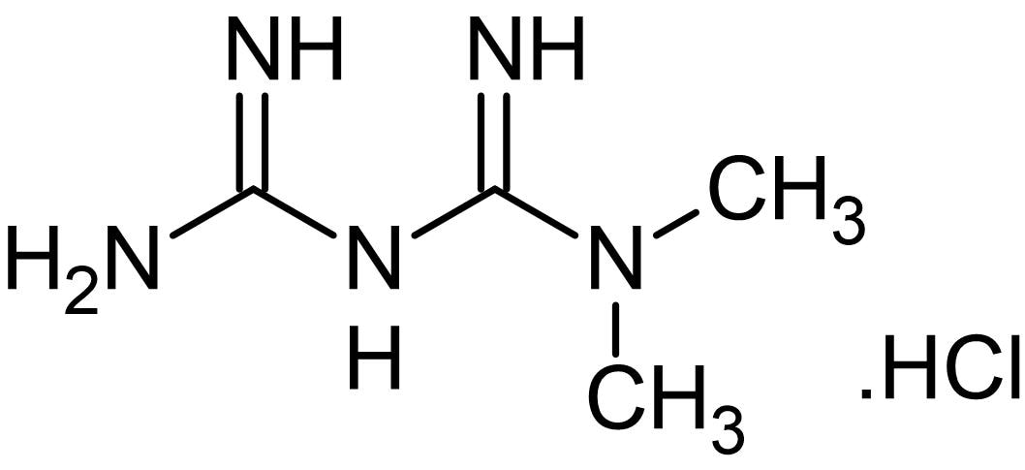
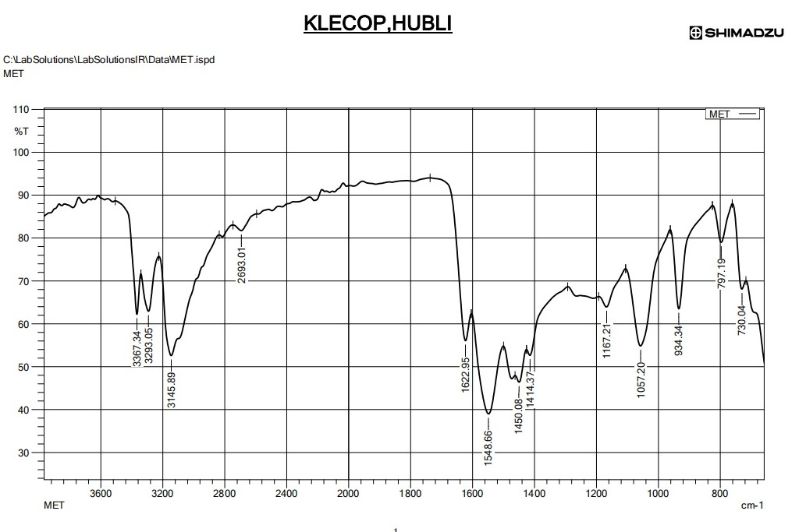
FTIR OF METFORMIN
Wavenumber (cm⁻¹) | Functional Group or Bond
3200-3600 | O-H stretching (alcohol)
3100-3000 | C-H stretching (alkanes)
1700-1600 | C=O stretching (carbonyl)
1560-1500 | N-H bending (amines)
1450 | C-H bending (methylene)
1250-1100 | C-N stretching (amines)
1000-900 | C-O stretching (alcohol or ether)
850-750 | C-H bending (aromatic)
C-H
C=O
C-H
C-N
C-O
N-H

Slide 19
SATURATION SOLUBILITY OF DRUG, SURFCTANTS AND CO-SURFACTANTS
Various natuarally occuring oils and synthetic oils were analyzed for metformin solubility to find out the best suitable oil for construction of pseudo ternary phase diagrams. To determine the ingredients needed to create microemulsions, the solubility of various surfactants and co-surfactants was also investigated.
An excess amount of metformin HCL[400mg] was placed in stoppered capped vials containing 3ml of vehicle thats is oil [linseed oil], surfactant [Span 20, tween 80] and co-surfactant [PEG,PG] with the vehicles. Then vials vials were shaken using a mechanical rotary shaker for 72hrs at 37⁰C. After attaining equilibrium conditions, the vials were centrifuged at 5000rpm for 15min, using centrifuge to obyain a clear supernatant liquid. Then the supernatant was collected and extracted for metformin

Slide 20
SOLUBILITIES STUDIES
DATA OBTAINED
PHASE TYPE | EXCIPIENT | SOLUBILITY [mg/ml]
Oil | linseed oil | 0.64
Surfactant | Span 20 | 16.4
 | Tween 80 | 23.8
Co-surfactant | PG | 10.2
 | PEG 400 | 12.7

Slide 21
DEVELOPMENT OF PSEUDO TERNARY DIAGRAM BY USING PHASE TITRATION METHOD
Linseed oil, lemon oil and olive oil was selected as oil phase from solubilities studies. Tween 80 and polyethylene glycol was selected as surfactant and co-surfacrtant respectively. Tween 80 was selected also on the basis of HLB value which is 15 and suitable for o/w formulation.
Surfactant and Co-surfactant were mixed [Smix] in 1:2, 2:1, 3:1 and 4:1 ratios. For each phase diagram, oil and Smix at specific ratio were mixed thoroughly in vortex mixer to give oil : Smix at different ratio from 9:1 to 1:9 ratio.
Each mixture was titrated with water and visual observation was made transparent o/w microemulsion.
End point for the titration was turbid appearance of mixture.
From findings of water titration method pseudoternary phase diagram was constructed with one axis representing aqueous phase, oil and surfactant and co-surfactant

Slide 22
PHASE TITRATION TABLE FOR [1:1, 2:1 AND 3:1]
OIL : Smix[%] | Smix % | Water [ Solvent %]
F1 10 | 39 | 51
F2 10 | 42 | 48
F3 10 | 40 | 50
F4 10 | 41 | 49
F5 10 | 42 | 48
F6 15 | 40 | 45
F7 10 | 39 | 51
F8 10 | 50 | 40
F9 15 | 45 | 40

Slide 23
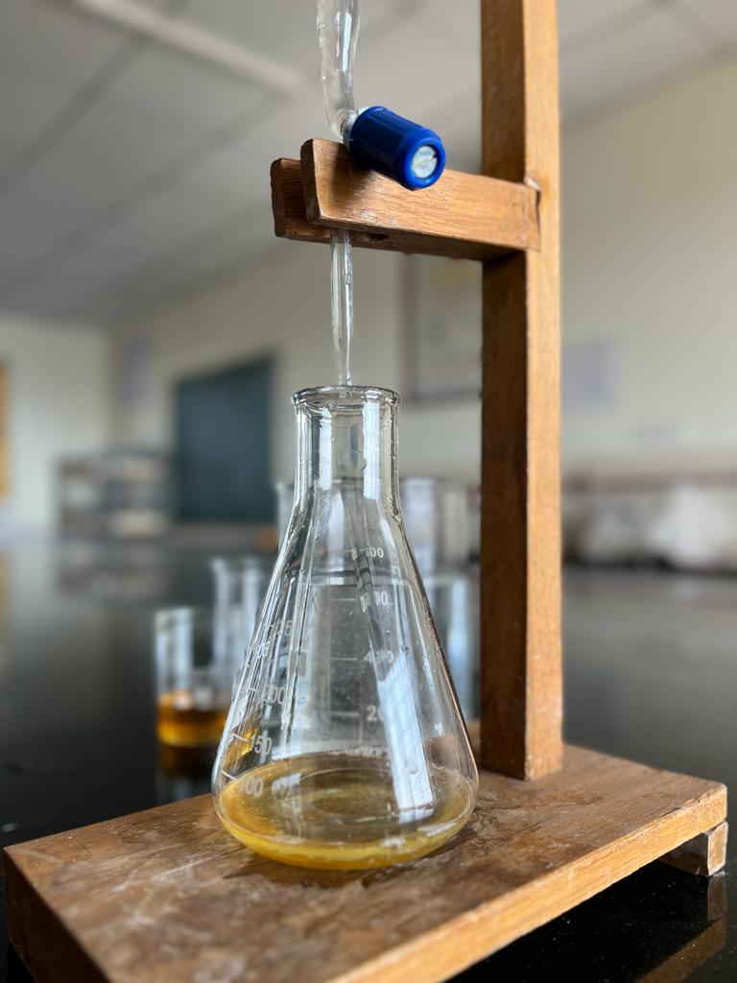
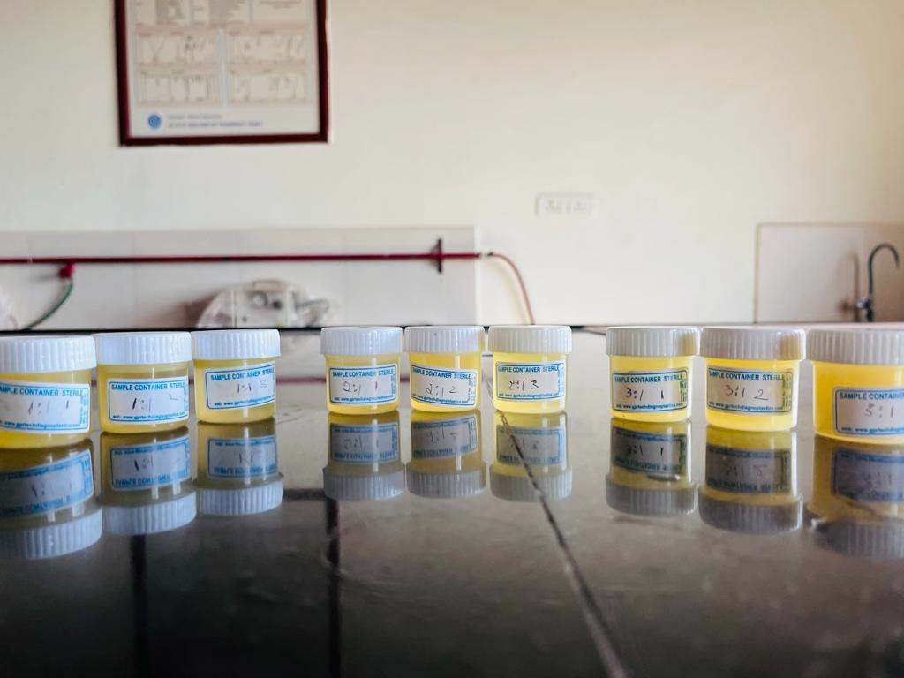
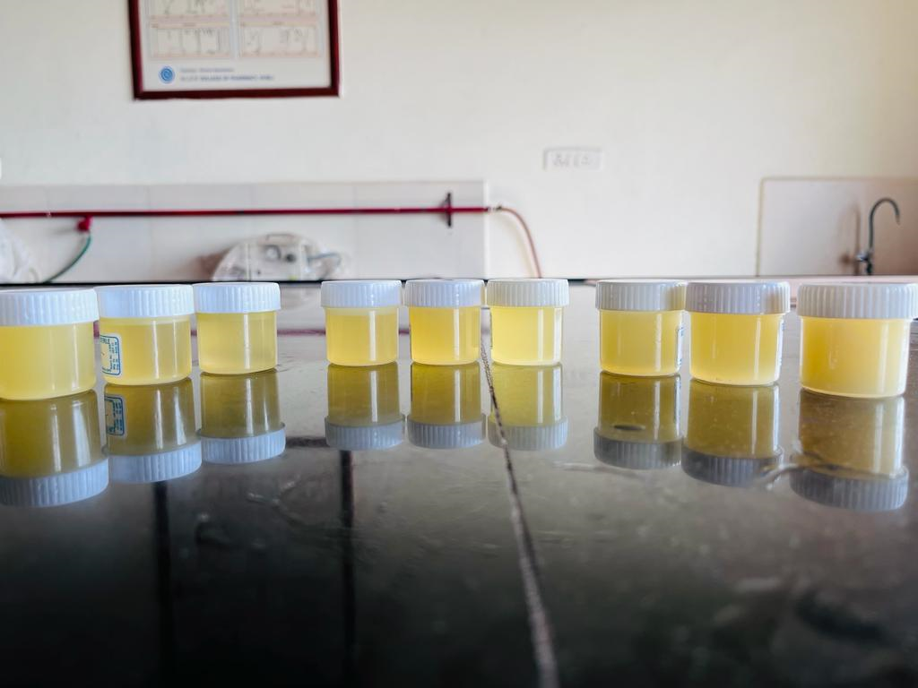
PHASE TITRATION MICROEMULSIONS

Slide 24
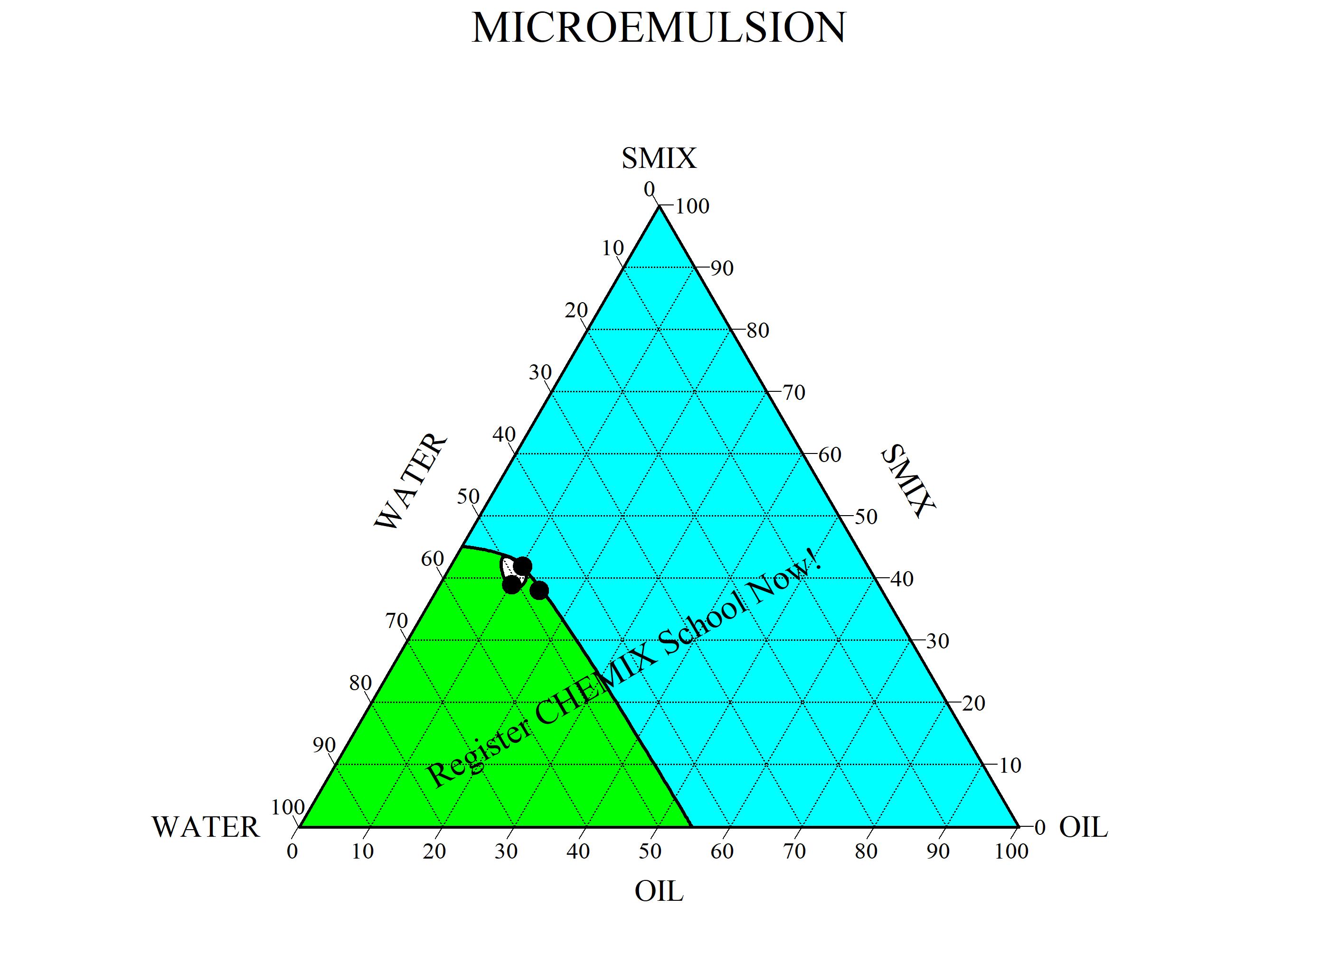
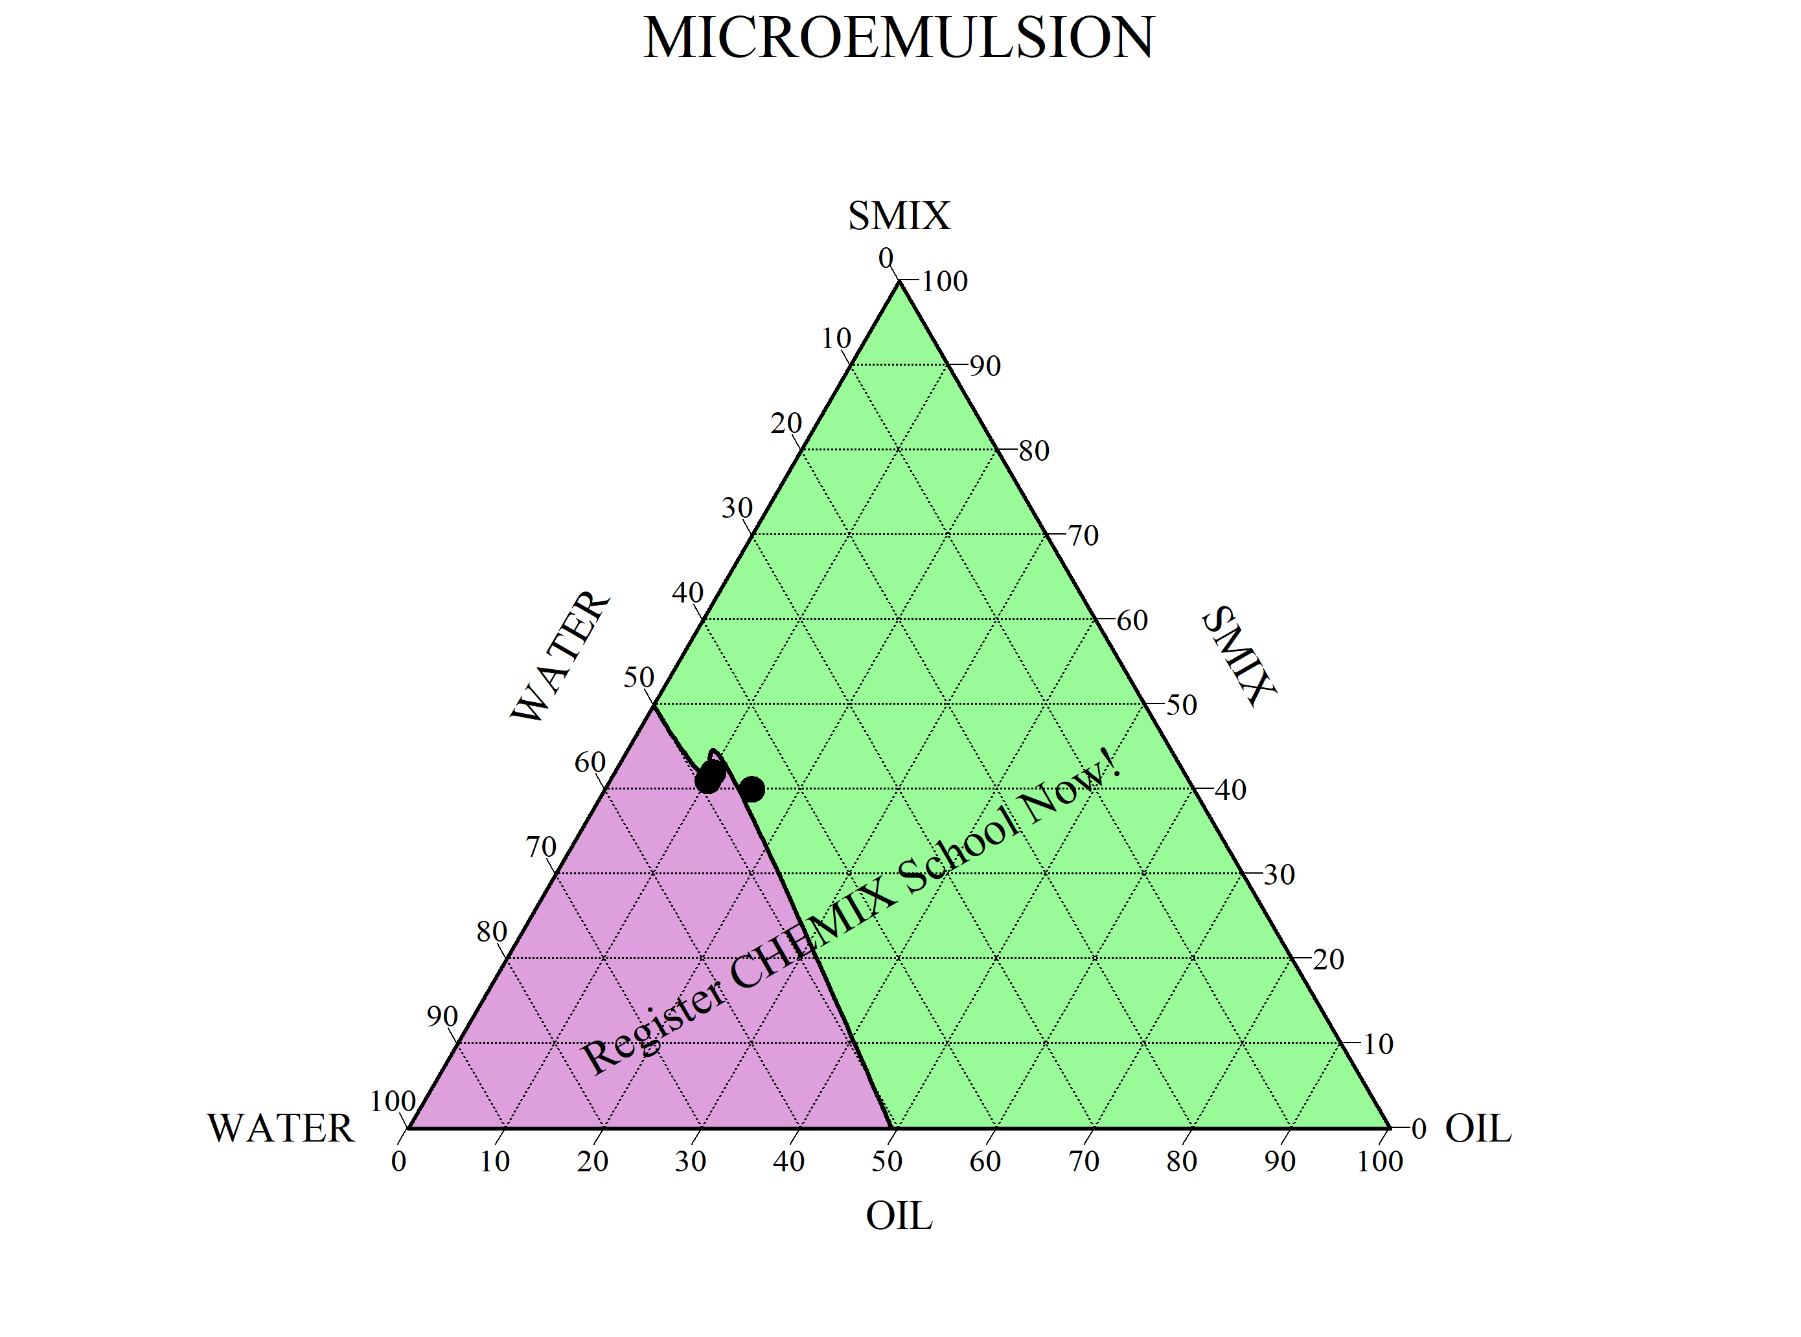
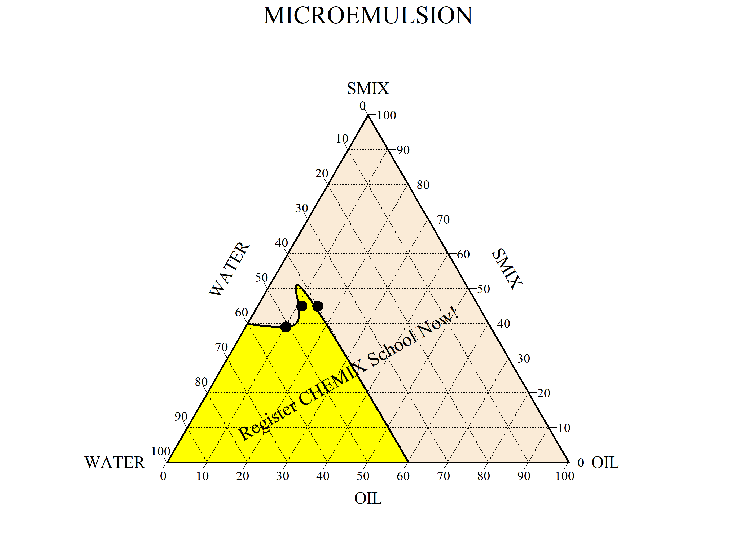
PSEUDO TERNARY DIAGRAM
1:1
2:1
3:1

Slide 25
FORMULATION OF MICROEMULSION BASED GEL
EMULSION
Linseed oil + tween 80 + PEG + water [ 3:2:1ratio ]
HPMC + Water [ soaked overnight ]
GEL BASE
Mixed in 1:1 ratio Glycerine, sodium benzoate and water is added to above mixture
↓
Mixture is mixed evenly by using ultra stirrer

Slide 26
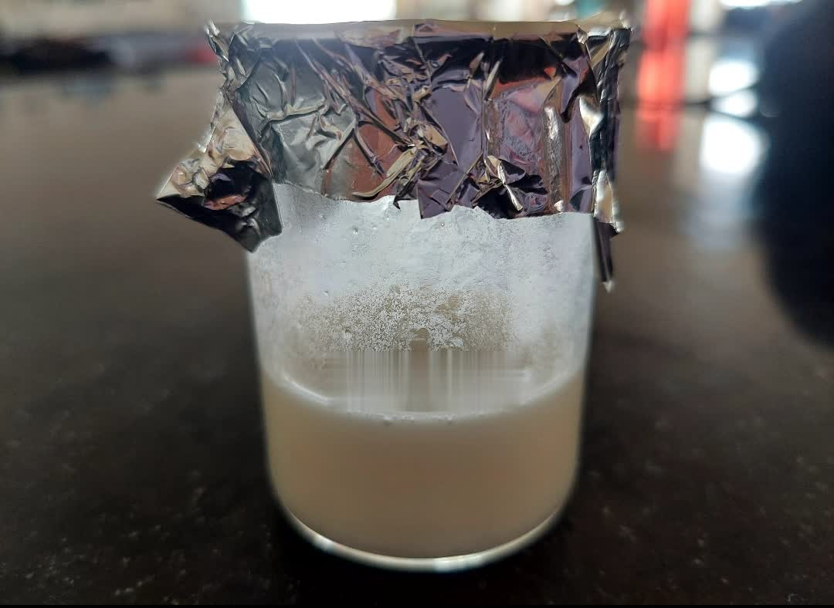
FORMULATION OF MICROEMULSIONS
SL NO | INGREDIENTS | QUANTITY | FUNCTIONS
1 | HPMC | 0.75 g | Gelling agent
2 | LINSEED OIL | 10 ml | Oil
3 | TWEEN 80 | 1.7 ml | Emulsifier
4 | PEG | 1.7 ml | Emulsifier
5 | GLYCERINE | 5 ml | Humectant
6 | SODIUM BENZOATE | 0.6 g | Preservative
7 | WATER | qs | Vehicle

Slide 27
RESULTS:PHYSICAL EVALUATION OF PREPARED MICROEMULSIONS
pH
%TRANSMITTANCE at 650nm
Viscosity
Drug content
Thermodynamic stability

Slide 28
RESULTS: EVALUATION OF PREPARED MICROEMULSION
FORMULATION CODE | PH | % TRANSMITANCE AT 650NM | VISCOSITY
F1 | 7.2±0.152 | 82.31 | 49.5±11
F2 | 6.8±0.143 | 98.25 | 50.1±10
F3 | 6.9±0.141 | 98.19 | 46.1±10
F4 | 7.0±0.150 | 97.36 | 60.5±9
F5 | 6.7±0.142 | 98.41 | 71.4±10
F6 | 7.1±0.151 | 96.10 | 69.7±11
F7 | 6.9±0.141 | 91.84 | 71.0±9
F8 | 6.8±0.143 | 93.91 | 98.9±11
F9 | 6.6±0.141 | 98.19 | 145.7±9

Slide 29
EVALUATION OF DRUG CONTENT AND THERMODYNAMIC STABILITY
FORMULATION CODE | DRUG CONTENT(%) | THERMODYNAMIC STABILITY (CENTRIFUGATION)
F1 | 60.5 | STABLE
F2 | 73.5 | STABLE
F3 | 85.5 | PHASE SEPARATION
F4 | 63.4 | STABLE
F5 | 80 | STABLE
F6 | 87.50 | STABLE
F7 | 119.4 | STABLE
F8 | 100 | PHASE SEPARATION
F9 | 97.3 | STABLE

Slide 30
COMPARISION OF DRUG CONTENT ALL FORMULATIONS

Slide 31
MEASUREMENT OF PARTICLE SIZE,PDI AND ZETA POTENTIAL
FORMULATION CODE | PARTICLE SIZE (nm) | PDI | ZETA POTENTIAL
F6 | 69.65 | 0.108 | -27.34
F8 | 91.26 | 0.169 | -42.1
F9 | 79.39 | 0.178 | -14.7

Slide 32
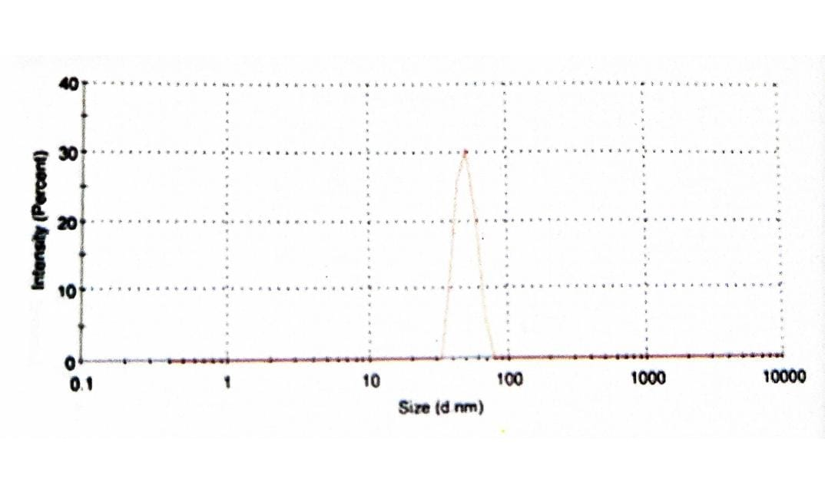
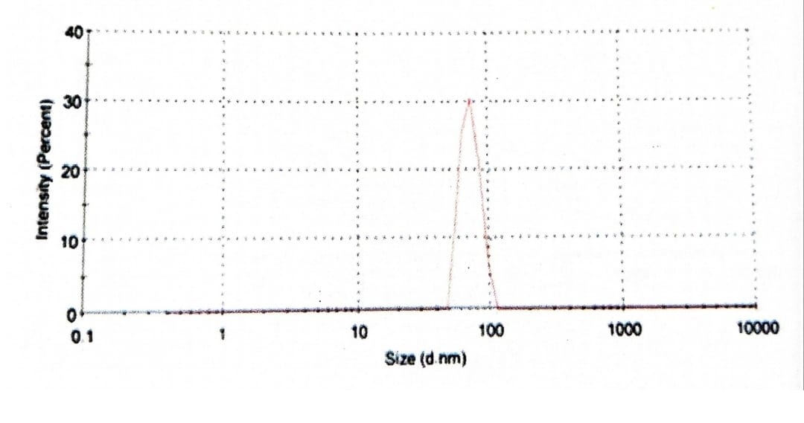
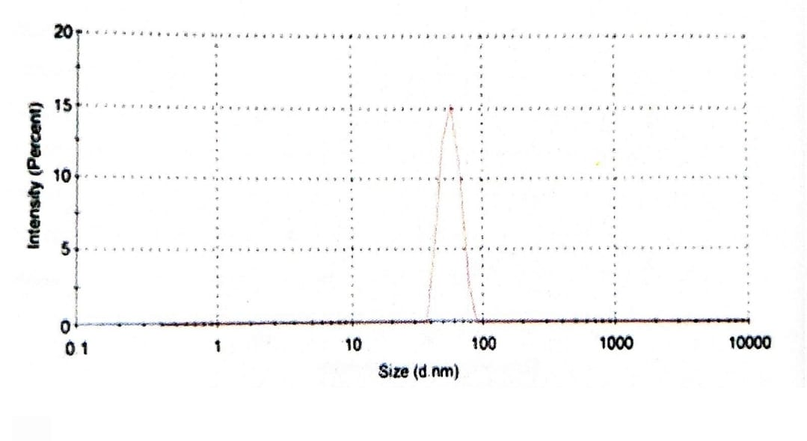
PARTICLE SIZE OF F6,F8 AND F9
F6
F8
F9

Slide 33
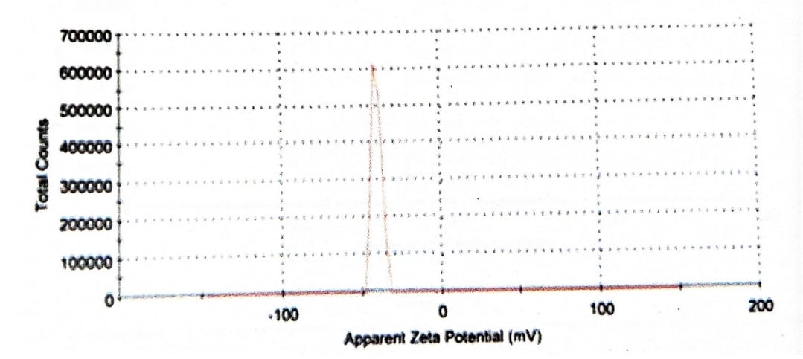
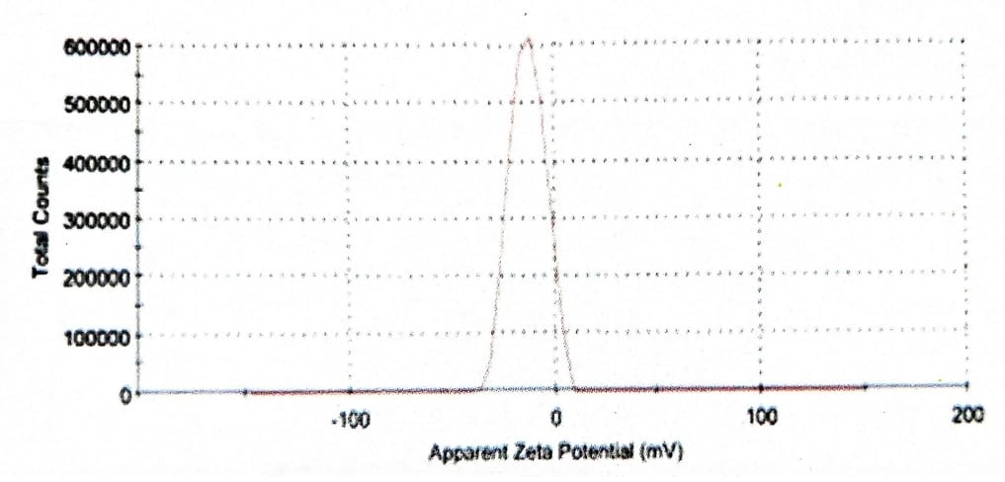
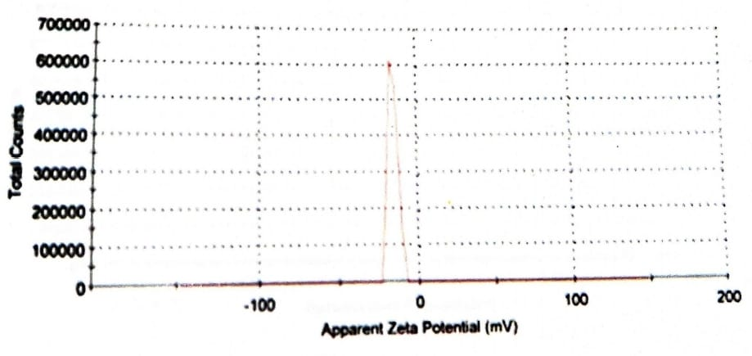
ZETA POTENTIAL OF F6,F8 AND F9
F6
F8
F9

Slide 34
PREPARATION OF OPTIMISED MICROEMULSION BASED GEL OF METFORMIN HCL {F6}
INGREDIENTS | MEG-1 (%W/W) | MEG-2 (%W/W) | MEG-3 (%W/W)
METFORMIN HCL | 0.1 | 0.1 | 0.1
LINSEED OIL | 15 | 15 | 15
SMIX (TWEEN 80 & PEG 400) | 40 | 40 | 40
HPMC | 1 | 1.5 | 2
WATER | 45 | 45 | 45
TRIETHANOLAMINE | q.s | q.s | q.s

Slide 35
EVALUATION OF OPTIMIZED MICROEMUL-BASED GELS
Physical evaluation
Color
Homogeneity
pH
Spreadability
Viscosity
Drug content

Slide 36
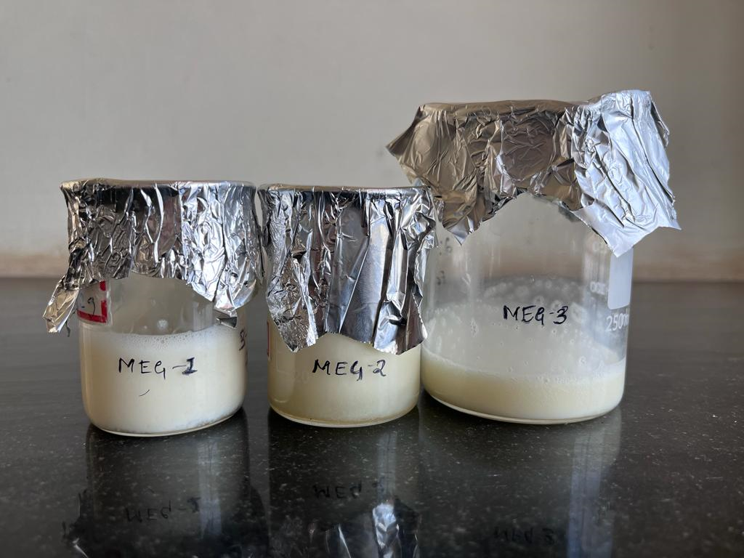
EVALUATION OF PHYSICAL APPEARANCE OF MICROEMULGELS CONTAINING METFORMIN HCL
FORMULATION CODE | COLOR | HOMOGENEITY
MEG-1 {%w/w} | WHITE | EXCELLENT
MEG-2 {%w/w} | WHITE | EXCELLENT
MEG-3 {%w/w} | WHITE | EXCELLENT

Slide 37
Evaluation of microemulsion based gel
MICROEMULGELS | pH
MEG-1{%w/w} | 6.5
MEG-2{%w/w} | 6.3±0.07
MEG-3{%w/w} | 6.5±0.06
±0.07
MICROEMULGELS | SPREADABILITY [g/cm/s]
MEG-1{%w/w} | 20.80±0.08
MEG-2{%w/w} | 20.70±0.05
MEG-3{%w/w} | 20.75±0.07

Slide 38
EVALUATION MICROEMULSION BASED GEL
MICROEMULGELS | HOMOGENEITY
MEG-1{%w/w} | Good
MEG-2{%w/w} | Good
MEG-3{%w/w} | Good
MICROEMULGELS | VISCOSITY
MEG-1{%w/w} | 1540±10
MEG-2{%w/w} | 1100±12
MEG-3{%w/w} | 850±10

Slide 39
EVALUATION OF MICROEMULSION BASED GEL
MICROEMULGELS | DRUG CONTENT [%]
MEG-1{%w/w} | 87.50
MEG-2{%w/w} | 60.75
MEG-3{%w/w} | 90.88

Slide 40
FUTURE WORK PLANS
In-vitro permeation study
Drug kinetic release rate
Thesis

Slide 41
REFERENCES
1.Singh R,Jat R,Narendra S,Rahul T. A Review on Liposomes as a Topical Drug delivery.
2.Ashara KC, Paun JS, Soniawala MM,Chnda JR,Mendapara VP,Mri NM. Microemulgel:an overwhelming approach to improve therapeutic action of drug moiety. Saudi Pharm J. 2016;24(4):452-7.
3.Sharma AK,Garg T,Goyal AK,Rath G.Role of microemulsions in advanced drug delivery.Artif Cells,Nano medicine Biotechnol.2016;44(4):1177-85.
4.Ogbechie-Godec OA,Elbeulek N.Melasma:an up-to-Date comprehensive Review.
5.Rajanala S,De CastroMaymone MB,Vashi NA, Melasma pathogenesis : A review of the latest research,pathological findings,and investigational therapies Dermatol Online J.2019;25(10).
6.Handel AC,Mikt,LDB,Miot HA, Melasma:A Clinical and epidemiological review.An Bras Dermatol:2014;89(5):771-82.
7.Jadhav A.Daundkar A,Morale D, Bhujbai N.Review on :Microemulsion a novel approach for drug delivery.IntI Pharm Sci Rev Res,2018;52(11):60-5.
8.Mckesey J, Tovar A,Amit G.Melasma Treatment :An J Clin Dermatol,2019-53P.
9.Kwon SH,Hwang YJ,Leu . SK,Park KC. Heterogenous pathology of Melasma nd its clinical implications. Int J Moll Sci.2016;17(6).
10.Sardana K,Ghunawat S.Rationale of using hypopigmenting of drugs and their clinnical applicaton in melasma.Expert Rev Clin Pharmacol.2014;891):123-34.
11.Sanadal khan Syed Umar jan Rahman gul Formulation and evaluattion of metformin HCL release from topical preparation using two different types of membrane SSSN-0975-7066.
12. Farid Abbd Elhmeed rheem badria topical metformin effective in treatment of melasma 1407.

Slide 42
DURATION / ACTIVITY | JUL | AUG | SEP | OCT | NOV | DEC | JAN | FEB | MAR | APRIL
SEMESTER 3
Literature search | ✓ | ✓ | ✓ | ✓ | ✓
Protocol submission | ✓
Drug and excipients procurement | ✓ | ✓
Solubilities studies | ✓ | ✓ | ✓
Placebo and Pre-formulation studies |  |  | ✓ | ✓
Journal club 1st presentation & Biostatistics 1st internal |  |  | ✓
Pseudo ternary CHEMIX |  |  | ✓ | ✓
1st dissertation protocol presentation |  |  | ✓
Batch formulation by phase titration method |  |  |  | ✓ | ✓ | ✓
Journal club 2nd presentation |  |  |  | ✓
Biostatistics 2nd sessional
Characterization studies |  |  |  |  | ✓ | ✓ | ✓
2nd dissertation protocol presentation |  |  |  |  | ✓
Biostatistics theory examination |  |  |  |  |  | ✓
Journal club 3rd presentation |  |  |  |  |  |  |  | ✓
Final dissertation protocol presentation
SEMESTER 4
Journal club presentation 1st,2nd & 3rd |  |  |  |  |  |  | ✓
Invitro permeation study
Thesis writing
Publication
Final project viva

Slide 43
Thank you

